Slide 1
Kenneth Grahame’s Invocation of Classical Epic Motifs in The Wind in the Willows or The Siren Song of Pan
Daniel Harris-McCoy
Assistant Professor of Classics
UH Mānoa

Slide 2
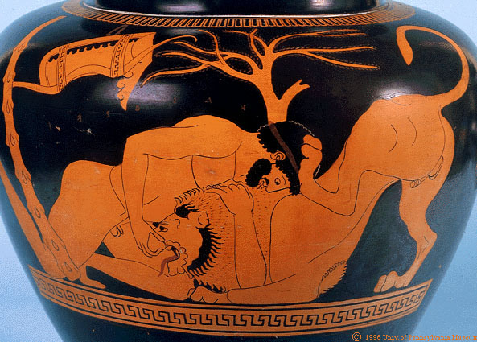
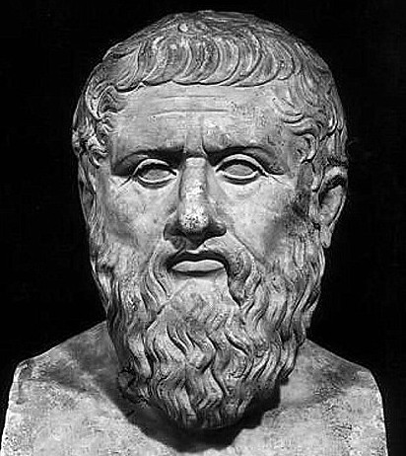
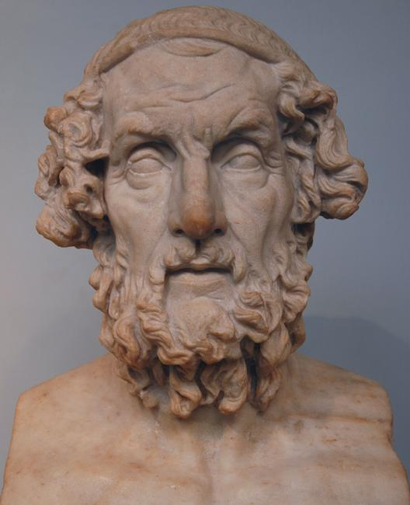
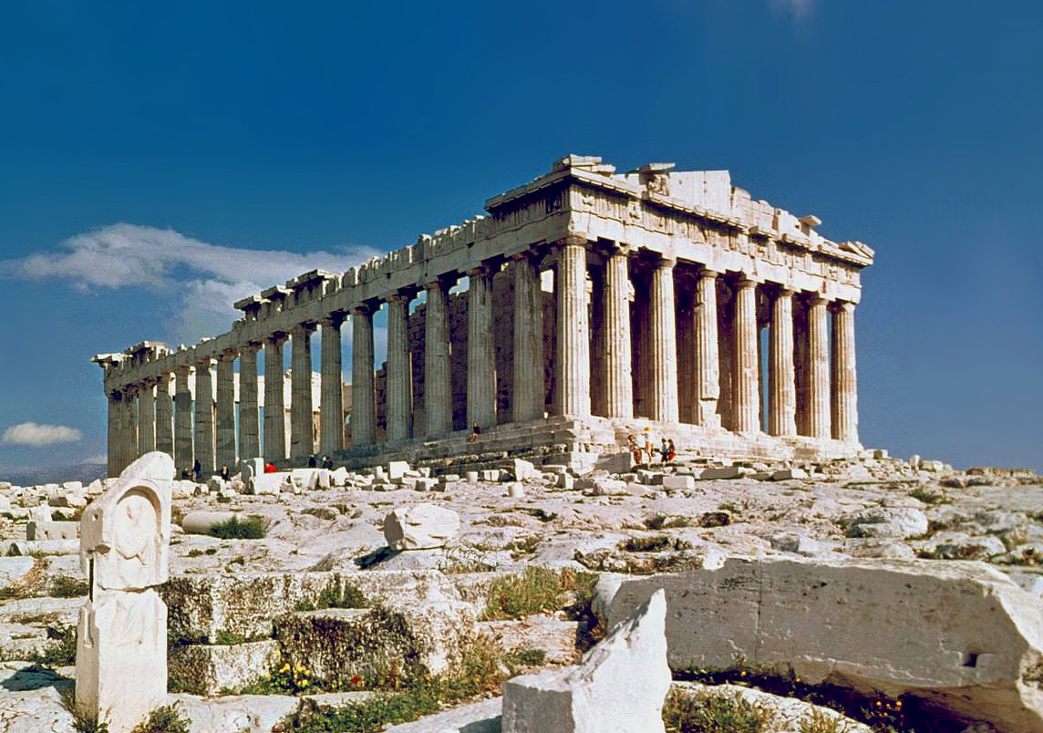
I’m a “Classicist”

Slide 3
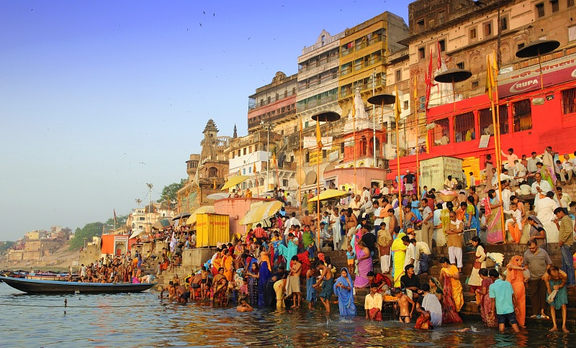
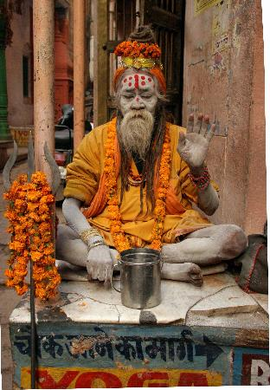
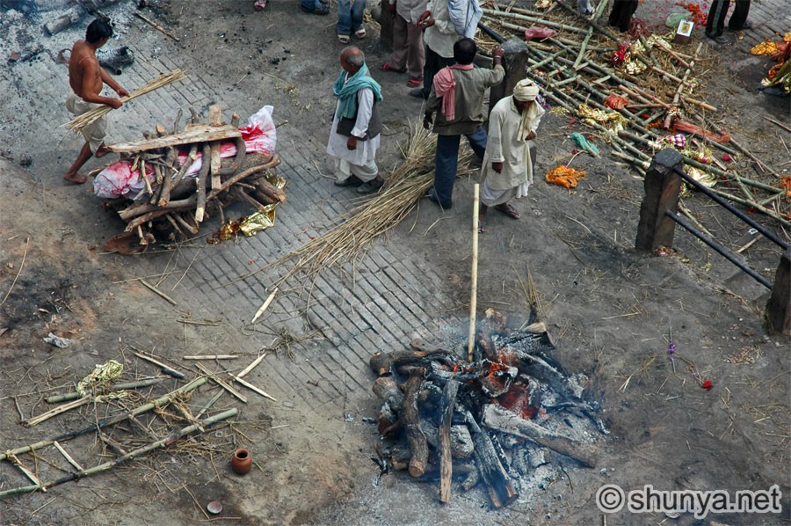
The Wind in the Willows: My “Conversion” Story
India, 2002-3

Slide 4
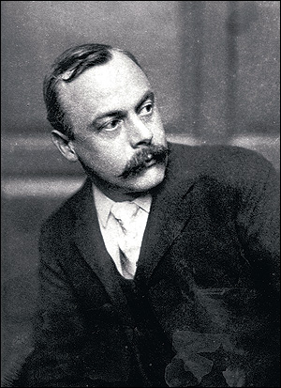
Kenneth Grahame, Classicist
“The education, in my time, was of the fine old crusted order, with all the classics in the top bin — I did Greek verse in those days, so help me! But these elements, the classics, the Gothic, the primeval Thames, fostered in me, perhaps, the pagan germ that would have mightily shocked the author of The Sabbath.”
--Kenneth Grahame, Unknown Letter

Slide 5
So What Is This Talk About?
Why The Wind in the Willows is a “classical” text
How Ch. 7 draws on – and transforms – two well-known classical episodes
What all this might mean

Slide 6
Reception of the Classics
How Ancient Greece and Rome have been perceived or treated in history
Gives insight into “meanings” of classical past
A way of fusing my love for WITW with my job

Slide 7
“Classical” Features of WITW
Classical twelve-chapter structure
Toad’s Odyssean Adventures:
Toad’s prison sentence
Re-taking of Toad Hall
Specific Classical Allusions:
Rat and Mole locate shelter
“On the Chance” (cf. si forte…si forte…)

Slide 8
Overview of Piper at the Gates of Dawn
One of the Introspective chapters (Ch. 7); takes place over the course of a night and is full of lush imagery
Rat and Mole go in search of Otter’s missing son, Portly
The animals proceed by boat and are drawn forth by mystic music
The chapter closes with a vision of the animal god Pan, who is guarding Portly

Slide 9
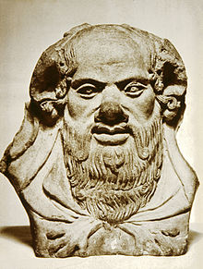
Virgil’s Eclogue 6 as Possible Model
Pastoral Setting
Encounter with the goat-like demigod, Silenus
Cosmic revelations
Silenus
Pan

Slide 10
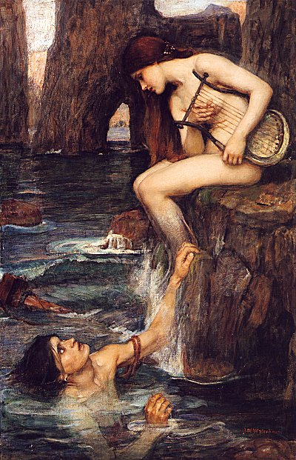
Homer’s Sirens and “Piper at the Gates”
Located at the mid-point of each text
Mystic encounters
Bewitching songs
“Marine” contexts

Slide 11
More Precise Parallels
Willingness to face death to hear the music
‘[Rat] might not refuse, were Death himself waiting to strike him instantly, once he had looked with mortal eye on things rightly kept hidden’ (174)
“…thin, clear, happy call of distant piping”
Cf. Siren’s song as λιγουρά: ‘clear’, ‘sweet’, ‘shrill’
Parallel island-settings

Slide 12
Homer, Virgil, “Piper”, and Katabasis
Descent and reception of prophecy/vision
Teiresias on Odysseus’ return and post-Ithacan future in Homer’s Odyssey
Anchises offers vision of the future glory of Rome in Virgil’s Aeneid
Central position in each text
Odyssey Bk. 11
Aeneid Bk. 6
WITW Ch. 7
Parallel use of death-imagery
‘“I feel just as you do, Mole; simply dead tired, though not body tired”’ (181-82) .

Slide 13
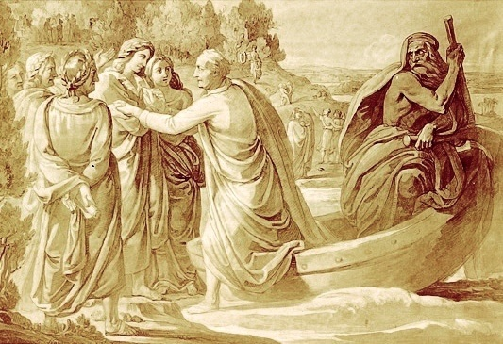
Topography
Sacred space
Grass and groves
Wafting music

Slide 14
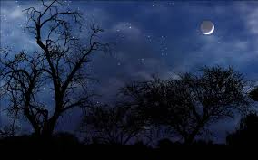
Prominence of Sleep and Dreams
Dreams suffuse Virgil’s Underworld
Father Anchises lures Aeneas to Underworld in dreams
The Famous Gates of Sleep (of Ivory and Horn)
Day/Night structure of narratives

Slide 15
So What?

