Slide 1
A Queer Library Alliance for Young People: Using Books with LGBTQ Content
Rae-Anne Montague
Thaddeus Andracki
raeannemontague.wordpress.com | rae7@hawaii.edu | tandracki.net | @tandracki

Slide 2
“Many times throughout my life people have been shocked when they find out my father is gay. ‘I had no idea,’ they say. ‘You’d never know just by looking at you.’ They make me feel like a rare species as their eyes scan me for any abnormalities they missed that could have tipped them off. Ladies and Gentleman [sic], step right up! Look closely at the child of a gay dad. No horns! No tail! In fact, she could pass for anybody’s child. What do people think kids of LGBT parents ‘look’ like?” (Garner 2004)
Garner, Abigail. Families Like Mine: Children of Gay Parents Tell It Like It Is. New York, NY: HarperCollins, 2004.

Slide 3
Intersectionality
“Consider an analogy to traffic in an intersection, coming and going in all four directions. Discrimination, like traffic through an intersection, may flow in one direction, and it may flow in another. If an accident happens in an intersection, it can be caused by cars traveling from any number of directions and sometimes, from all of them” (Crenshaw 1989).

Slide 4
Foundations
“The American Library Association stringently and unequivocally maintains that libraries and librarians have an obligation to resist efforts that systematically exclude materials dealing with any subject matter, including sex, gender identity, gender expression, or sexual orientation.”
http://www.ala.org/advocacy/intfreedom/librarybill/interpretations/accesslibrary

Slide 5
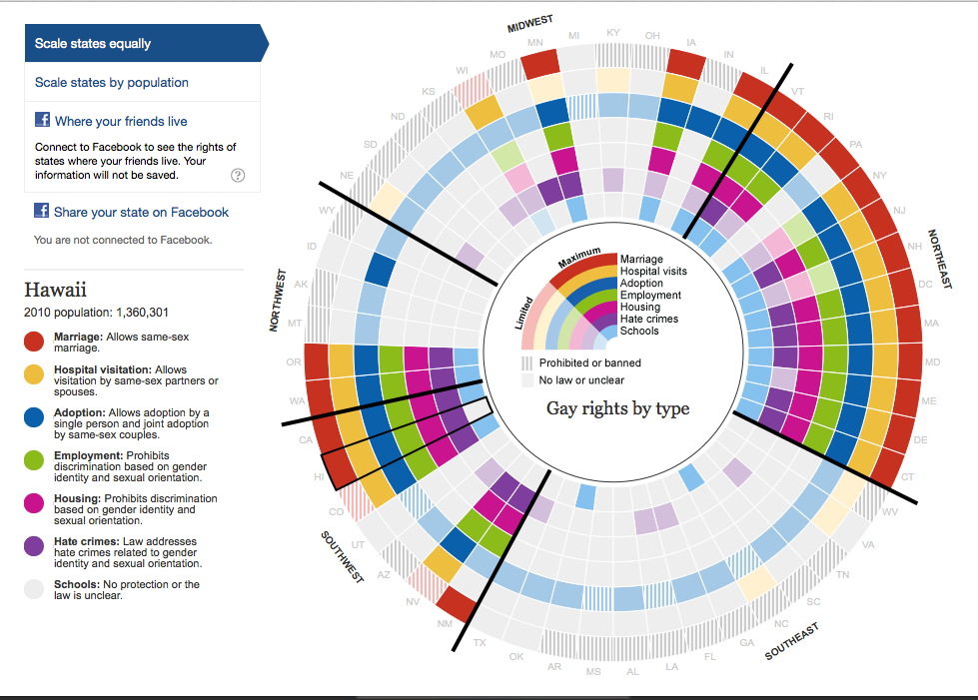
http://www.theguardian.com/world/interactive/2012/may/08/gay-rights-united-states

Slide 6
Topics
Selecting materials with GLBTQ content to support personal and community goals
Challenges to providing access to queer materials
Developing collections and programming with GLBTQ content aligned with emerging needs of children and young adults

Slide 7
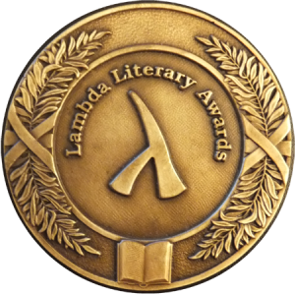
Selection: Awards

Slide 8
The Rainbow List

Slide 9
Goodreads for Collection Development and Readers’ Advisory
https://www.goodreads.com/list/show/3392.LGBT_for_YA#17237214
https://www.goodreads.com/list/show/15647.LGBT_Young_Adult_YA_Literature#17237214
https://www.goodreads.com/list/show/653.Best_YA_Fiction_with_GLBTQQI_themes_characters?#17237214

Slide 10
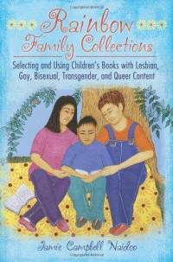
Professional Resources for Selection
Jaime Naidoo, Rainbow Collections
Carlisle Webber, GLBTQ Teen Literature: A Guide to Reading Interests
Christine Jenkins and Michael Cart’s new bibliography (see handout)
Patricia Sarles, Gay-Themed Picture Books for Children http://booksforkidsingayfamilies.blogspot.com/

Slide 11
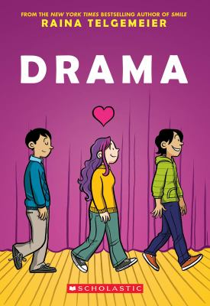
Media

Slide 12
Authors to Know
Malindo Lo
David Levithan
Hannah Moskowitz
Tim Federle
Scott Tracey
Lesléa Newman
Libba Bray
Maureen Johnson
Julie Ann Peters
Francesca Lia Block
Alex Sanchez
Todd Parr
Cris Beam
Brent Hartinger
Bill Konigsberg
Michael Willhoite
Tomie dePaola
Nancy Garden
Ellen Wittlinger

Slide 13
Additional Top Picks
And Tango Makes Three, Justin Richardson, Peter Parnell, and Henry Cole
Willie & Uncle Bill, Amy Schwartz
Morris Micklewhite and the Tangerine Dress, Christine Baldacchio
One in Every Crowd, Ivan Coyote
I Am J, Cris Beam
The Miseducation of Cameron Post, emily m. danforth
King and King, Linda de Haan
Better Nate than Ever, Tim Federle
Gertrude is Gertrude is Gertrude is Gertrude, Jonah Winter
Two Boys Kissing, David Levithan
What Makes a Baby, s.e. smith
Aristotle and Dante Discover the Secrets of the Universe, Benjamin Alire Sáenz
Grasshopper Jungle, Andrew Smith
Beyond Magenta: Transgender Teens Speak Out, Susan Kuklin
A Tale of Two Mommies/A Tale of Two Daddies, Vanita Oelschlager

Slide 14
While it’s important for all students to have access to a broad range of resources, as Rauch (2010) describes, it is essential for GLBTQ students to see themselves reflected in print and other media to affirm their identities.
Rauch, Elisabeth W. "GLBTQ Collections Are For Every Library Serving Teens!." Teacher Librarian 39.1 (2011): 13-16. Academic Search Premier. Web. 6 June 2014.

Slide 15
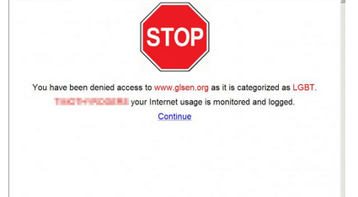
Challenges
https://www.aclu.org/blog/lgbt-rights/dont-filter-me

Slide 16
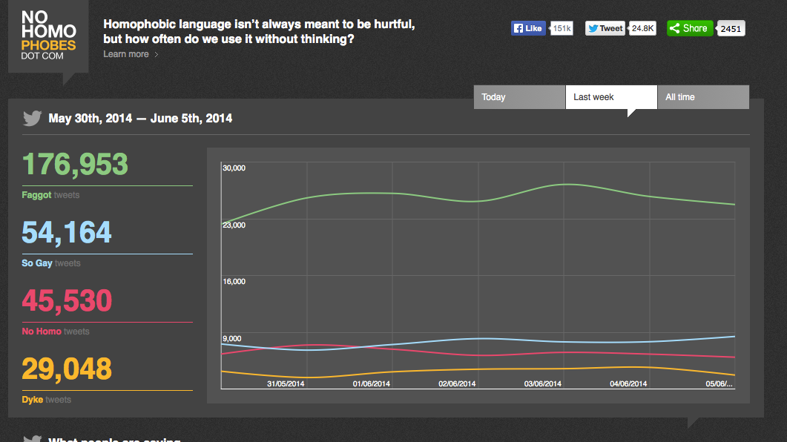

Slide 17
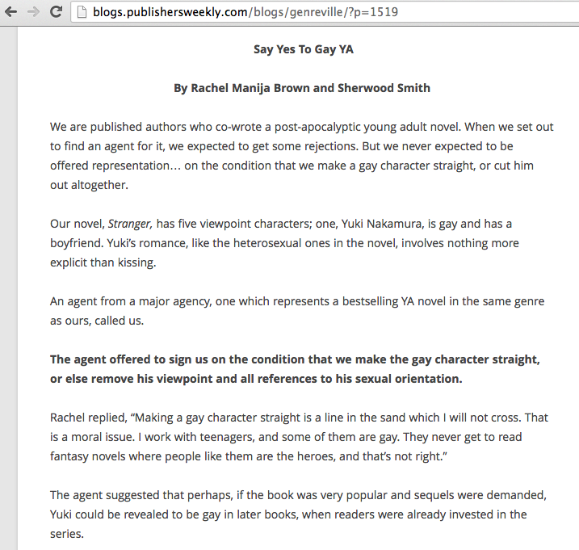

Slide 18
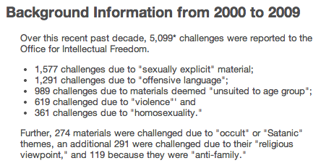

Slide 19
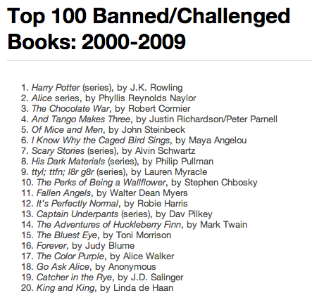

Slide 20
Programming

Slide 21
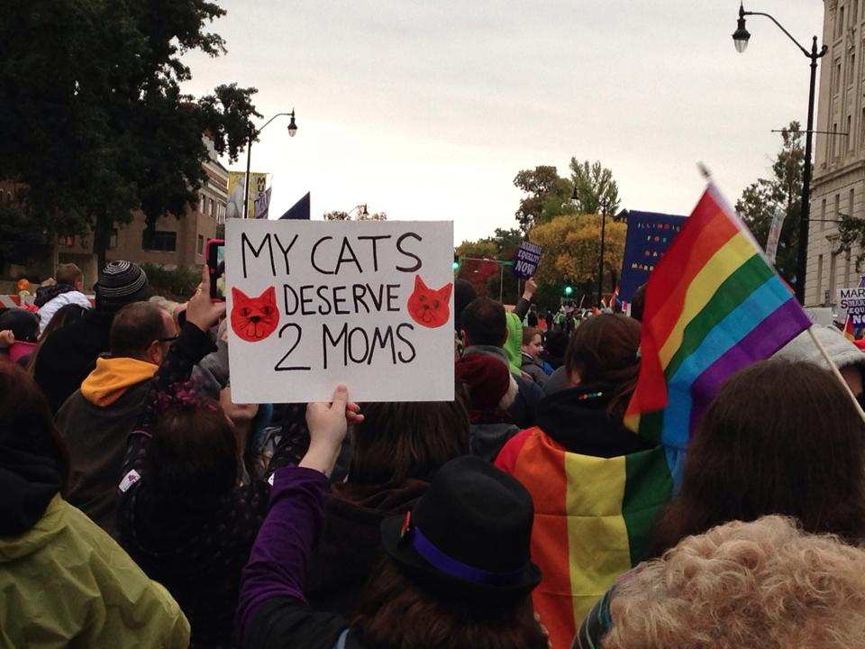

Slide 22
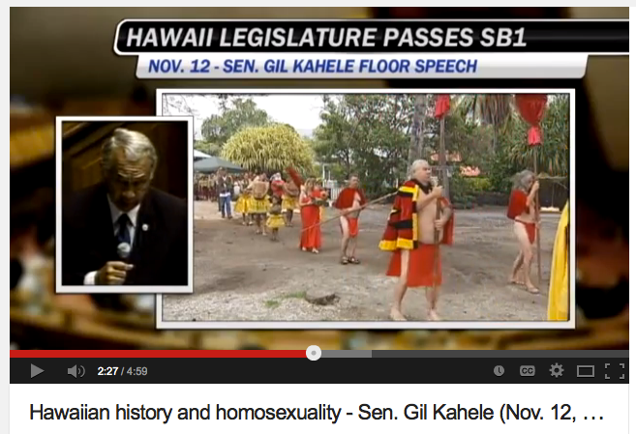
https://www.youtube.com/watch?v=FYg9h3BlCo8

Slide 23
Local Resources
LGBT Student Services Center at UH and community colleges
HPU OUTSpoken
Equality Hawai‘i
LGBT Center Waikīkī
GSA Hawai‘i
Life Foundation
RainbowFamily808

Slide 24
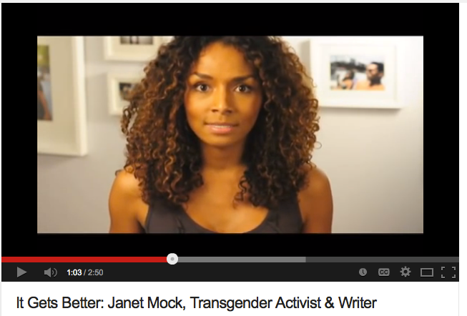
https://www.youtube.com/watch?v=g0t-Ft-vRUE

Slide 25
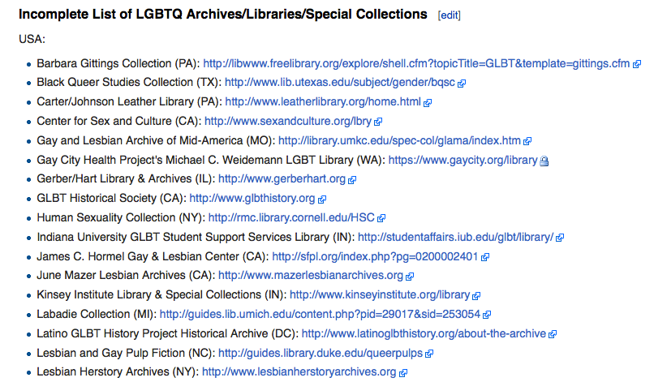
Libraries and the LGBT Community
http://en.wikipedia.org/wiki/Libraries_and_the_LGBT_community

Slide 26
Reading Group Guides
http://books.simonandschuster.com/Aristotle-and-Dante-Discover-the-Secrets-of-the/Benjamin-Alire-Saenz/9781442408937/reading_group_guide
http://books.simonandschuster.com/Perfect/Ellen-Hopkins/9781416983255/reading_group_guide

Slide 27
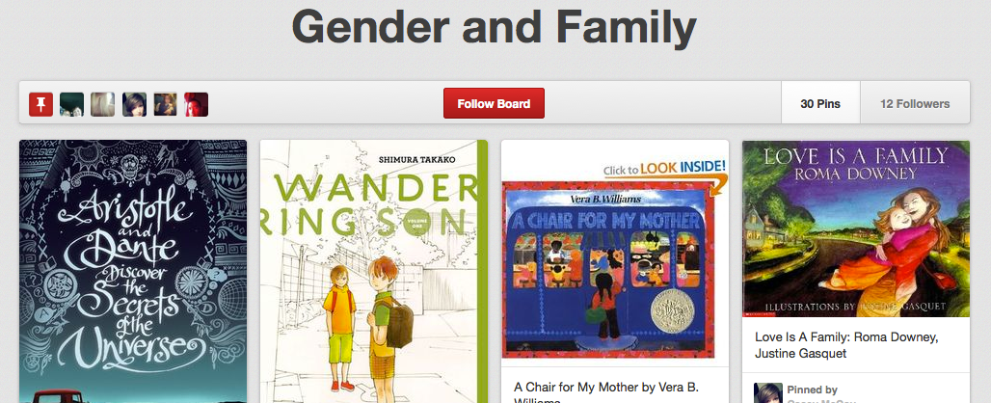
Pinterest

Slide 28
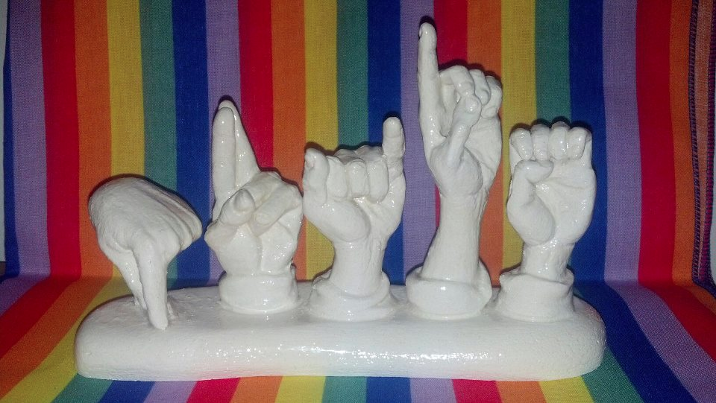
Questions, comments, concerns, hopes, dreams, desires, aspirations, rants, anything else you’d like to share?
raeannemontague.wordpress.com | rae7@hawaii.edu | tandracki.net | @tandracki

