Slide 1
For the Love of Nonfiction
Tisha Aragaki
Children’s Literature Hawaii Conference
June 6, 2014

Slide 2
Introduction
Me…
Not an expert, just an advocate…Learning as I go
Will be sharing about nonfiction for K-12, with a bias more towards middle elementary and older.

Slide 3
YOU!
I’d like to know a little about you!
Notes:
This will help me if I continue doing these presentations elsewhere, thanks!

Slide 4
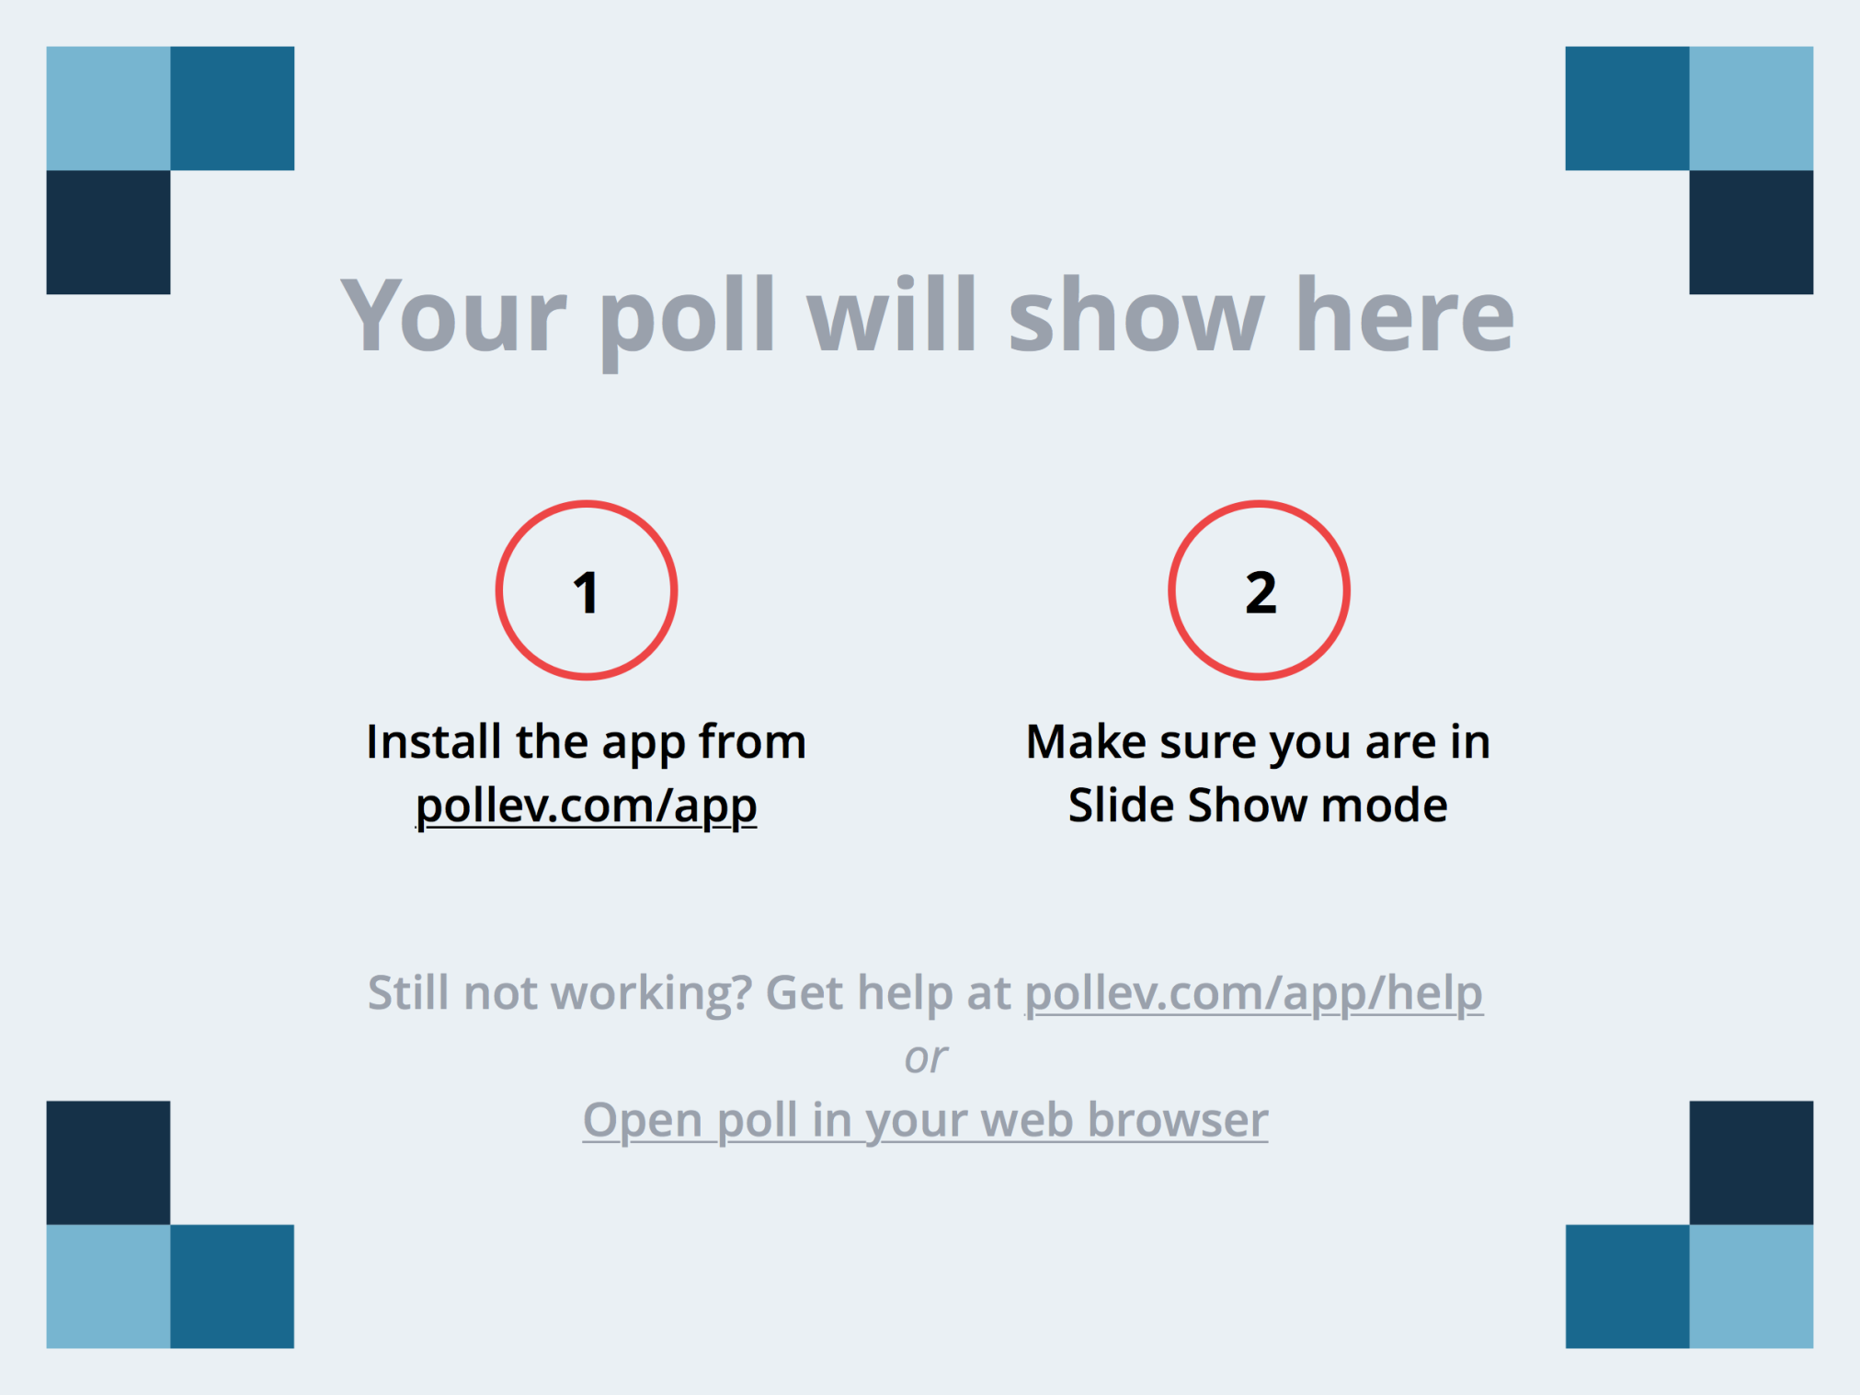
Notes:
A little about you... http://www.polleverywhere.com/multiple_choice_polls/guFSl4kQvobKS9J

Slide 5
What is quality nonfiction and why is it important?
Quality nonfiction is a work that is composed of quality content and writing, is organized well, and is well designed.
It is important because it broadens general knowledge, teaches skills that are often not addressed in fiction, and is a major focus of the new Common Core State Standards.

Slide 6
What are your “feels” about Nonfiction?
What does the term make you think of?
Boredom
Un-engaging delivery
Cold-hard facts
What does it make you feel?
Yucky?
Angry?
Bored?

Slide 7
Notes:
How would you describe non-fiction? https://www.polleverywhere.com/free_text_polls/BvTXegtUsbzC9Dn

Slide 8
What does it mean?
Factual information
Narrative and creative nonfiction
Informational text
Literature (Literary Nonfiction)
Poetry
Short Stories
Folklore and Fairytales
Notes:
Let’s go over the basics again? What is nonfiction? It is usually thought of factual/true information. But it also includes literature, like poetry, collections of stories, and then it also includes things like nursery rhymes, fairytales and folktales. (The standards for the way these publications are made are different from what we normally think of as fiction. There are frequently notes and reference information about the origins of stories or their creators, for example. Rarely does a collection of Robert Frost poems or greek myths look like something that would fit on the shelf with Twilight or the Wizard of Oz.)

Slide 9
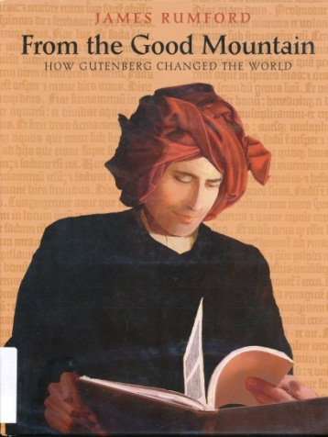
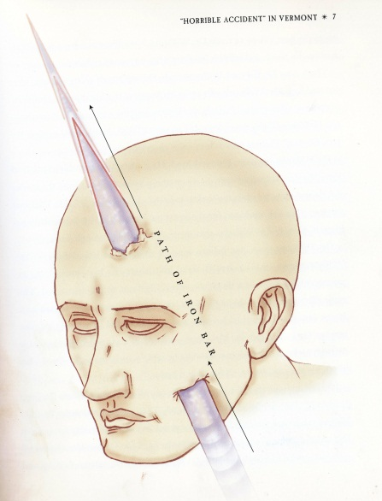
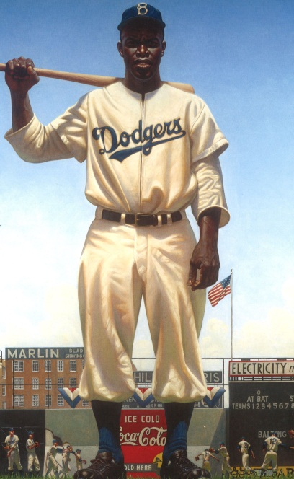
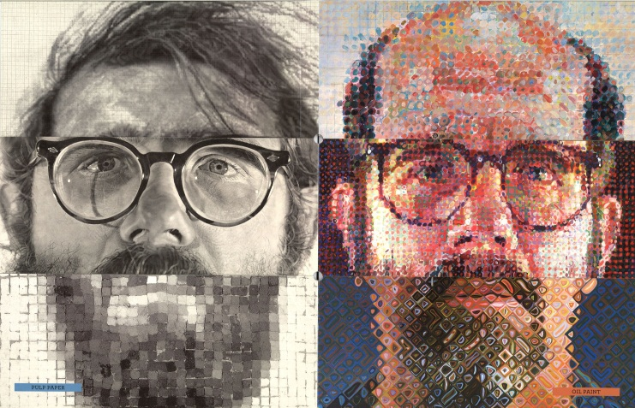
What is there to love about nonfiction?
It can:
Be exciting
Be creative
Tell just as amazing a story as you can find in any novel
Be a great mode of learning skills or just new information
Notes:
Sometimes people forget that nonfiction can be creative! it can be narrative, it can tell a story, it can be exciting.
It doesn’t need to be cookie-cutter or just straight informative text.
It can be a great mode of learning- and I don’t mean just through the information. It can teach the reader so much about so many other aspects of published indirectly, design, photography, illustration, etc. More on that later.
Mostly people think of nonfiction as something to teach with, something you pick up if you need to do research or a school assignment, but not really pleasure reading. It can be pleasure reading. Anything well written can be compelling and hard to put down.

Slide 10
Again…why is nonfiction so important?
Primarily---
Helps students develop their background/general knowledge.
Helps students become acquainted with and develop skills that are often not addressed in narrative fiction.
Like graphs and charts, basic research process.
Common Core State Standards language arts focus shift.
Can help motivate young readers by tapping into their interests!
Critical thinking skills are enhanced with exposure to quality creative informational texts.
Students must be taught to make critical deductions using several resources.
Critical thinking must be taught along with creativity (often thought of as opposing approaches)
Creativity cannot be taught as separate from critical thinking - “Creativity is not only about generating ideas; it involves making judgments about them.”
Notes:
As I mentioned before my primary points are that…
But secondarily it can help motivate reluctant readers, critical thinking
Some interesting points made by Jason Ohler (Uncommon Core)
“Students that read roughly 21.1 minutes a day encounter 1.8 million words a year, while students reading less that 1 minutes per day are encountering only about 8,000.”

Slide 11
General Knowledge
Nonfiction introduces readers to real-life experiences and occurrences.
Young readers are very inexperienced, nonfiction is an important way of teaching them about topics or events that are real, have happened or are happening.
“General knowledge” Duh! – history, general skills, awareness of the rest of the world are all necessary to function well in college, work, and society.
They can find new or renewed inspiration in a fascinating topic.
Notes:
Real life experience and occurrences, but not necessarily things that are everyday or common. These things can be totally new to a reader, or build upon something that they are fascinated by but know very little about.

Slide 12
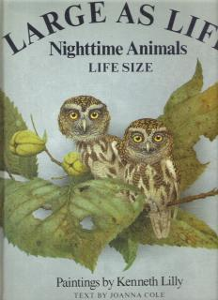
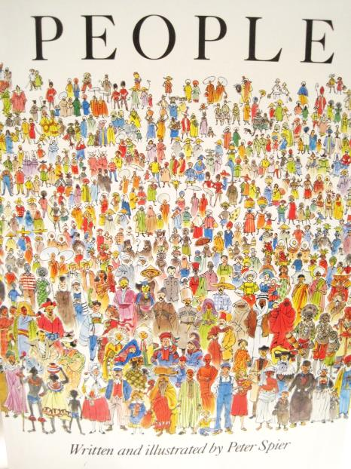
What are those skills?
There is more to quality nonfiction than the successful imparting of information.
Kids can pick up skills in:
Writing
Presentation
Research
Exposure to new ideas/interests like photography or illustration
Notes:
Quality and varied informational texts “can help [readers] see that the real world can be just as surprising and intriguing as make-believe.
“It’s not just how much students read that matters, but also what they read.”
When I was little, my favorite thing in the whooole wide world was animals. Everything animals. I didn’t care about almost anything else. However, there were two books that left the most lasting impacts on me. When I was in 1st grade I fell in love with the Large as Life book, and borrowed it so many times, that when it needed to be weeded my school librarian gave it to me. There is a picture of a mouse deer in it, that I used to prop up on the table next to me and pretend it was my pet, because it was the real size and I was fascinated by it. However, what I came away with was also an appreciation of the art. The work of Kenneth Little was so detailed, even in 1st grade I wanted to be able to do scientific illustration and paint that realistically. I can’t but I’ve tried, and I have a great respect for anyone that can produce work like that. It’s given me a very deep appreciation of art. The other was People by Peter Spier. My school librarian shared this with us in about 2nd or 3rd grade. Usually, classified as a picture book instead of non-fiction. I loved the illustrations, because they were so tiny, and impressionistic. Again, art appreciation. But, there are great lessons about acceptance, and human diversity and culture… and it was something of an indirect influence on my becoming an anthropology major and librarian.
In these cases, for me… truth was more interesting than any made up story. The fact that there was a deer small enough to put on my table. Or the fact that someone else’s written language could look like an art-form compared to what I was used to was more interesting than the adventures of Corduroy.

Slide 13
The place of nonfiction in the Common Core
Common Core is coming whether we like it or not.
Focus in Common Core is meant to encourage learning and application of Expository and Argumentative Writing and increased skills in presentation of knowledge (gr. 6-12)
intent to teach reading writing and speaking that is grounded in evidence from text both literary and informational.
intent to teach complex reasoning and writing skills based on stepped exposure to more complex text. Preparing students for college and professional demands.
Notes:
Aside from just a boldface push from an advocate, why ELSE is knowledge and appreciation of nonfiction important?
Common Core State Standards
Not federal. Created by National Governors Association Center for Best Practices, Council of Chief State School Officers But adopted by 45 (now 44) states to replace the standards in those subject areas. Language Arts and Literacy in History, Social Studies, Science and Technical Subjects AAAAND Mathematics

Slide 14
What to look for in quality Nonfiction?
Quality of:
Content & Writing
Print features
Organization
Design/Visual presentation
Graphic Aids – Graphs, Diagrams, Figures, Maps
Illustrations, YES! PICTURES!
Research/Accuracy
Notes:
There are several criteria that make up a quality piece. This is put together from a chart I got at another conference, that I’m handing out to you. I’ll share the criteria with you and then show you some examples.
In no particular order, will vary depending on audience. As well as educational, you want something eye-catching for your age group, that will hold their attention. This is why design and organization of the information is important. ONCE you have their attention, you need them to actually be interested in learning something, so make sure it’s GOOD, RELIABLE information!

Slide 15
All Nonfiction is not created equal…
My “un-favorites”
Cookie-cutter series non-fiction
Some types of Hi-Lo
Missing source information
Sensationalist without substance
Poor design
My favorites
Well-planned series
Authoritative authors
Writing that does not talk down to readers
Good design
Good graphics
Excellent notes and citations
Notes:
My “unfavorites” are those that lack the criteria shared … they don’t exercise creativity in writing or presentation, have poor or very basic organization and design.
Sometimes what seems like an otherwise wonderful book fails in some aspect. This will happen, of course, as nothing is really perfect. Sometimes this has to do with budget. It cost more to publish on glossy pages and in color. It costs more and takes longer to clear the use of photos, quotes, and other possibly copyrighted content. It takes time to put together quality research and of course, it takes time to do good research.
Primarily, we are focusing on those things that should be within the control of an author and publisher.
There’s nothing wrong with a little sensationalism for kids. Especially for boys, sometimes that’s the best way to get them reading…but if it’s all flash, and no substance, the reader will get very little out of it.
Notes and citations may seem boring and unimportant for young readers, but it is incredibly important. They need to learn how to vet resources. Of course, for younger readers, notes may not be the most important thing. Sometimes, a book for very young readers is just telling a true story. However, in books that are based on research, there should be something, noting where the information came from.
In a collection of folktales, for instance there should be source notes or information on where the story came

Slide 16
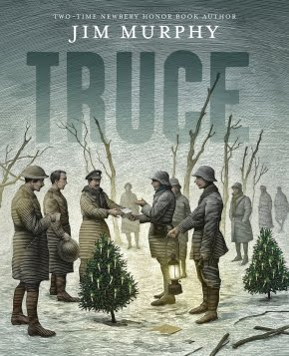
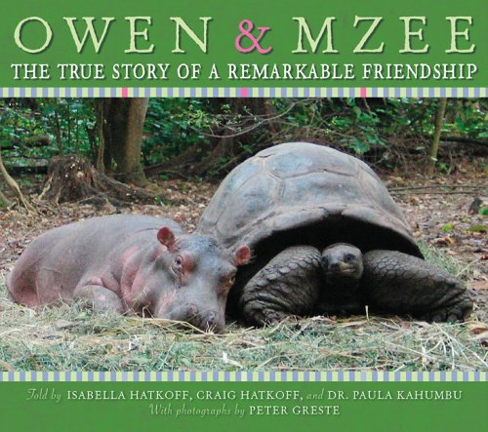
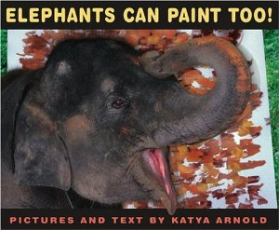
Content & Writing
Look for books that are:
Content Rich (according to age or reader)
Goes beyond straight reporting of facts
Written/edited well
Makes topic interesting and exciting
Addresses reader with respect
Notes:
Effective nonfiction --- look for: Sometimes going beyond straight reporting of facts means, it’s presented in a creative way. Whether in riddles, like What do you do with a tail like this? Or Poetry. Sometimes it’ narrative and will tell you the story of an individual or an event that represents a broader topic, instead of strictly reporting about a general topic.
Aside from making the experience more enjoyable, and teaching something new…
Reading well written works can help a person write better.

Slide 17
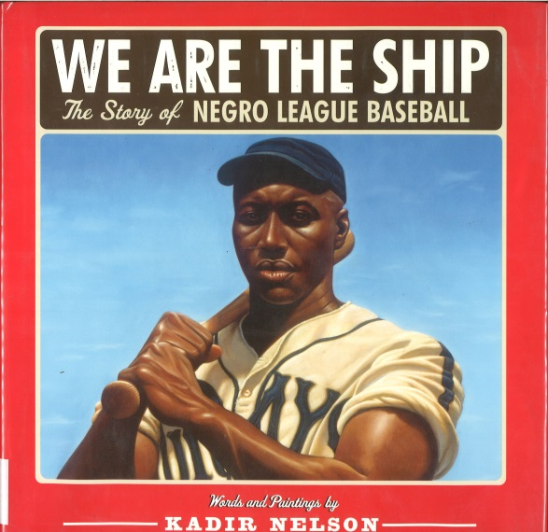
We Are the Ship- Quality content (gr.4+)
“Now there was never any written rule that prohibited Negroes from playing professional baseball, but soon after 1887, somehow Negroes
all over couldn’t get on a professional baseball team. Come to find out that all the white owners had gotten together in secret and decided to do away with Negroes in professional baseball…”
Notes:
“Now there was never any written rule that prohibited Negroes from playing professional baseball, but soon after 1887, somehow Negroes all over couldn’t get on a professional baseball team. Come to find out that all the white owners had gotten together in secret and decided to do away with Negroes in professional baseball…”

Slide 18
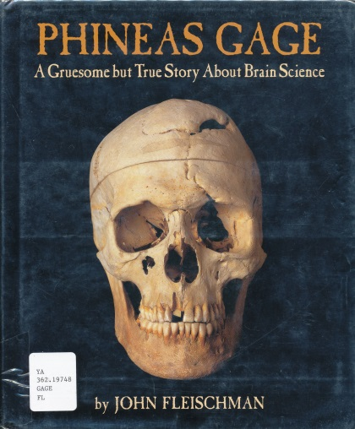
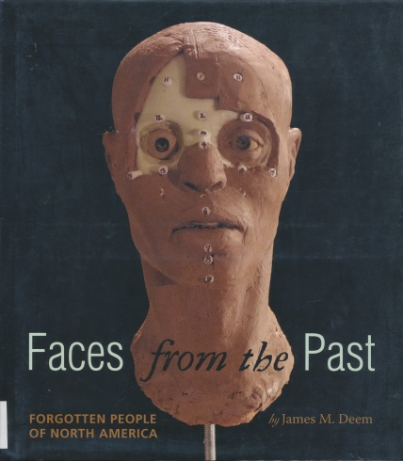
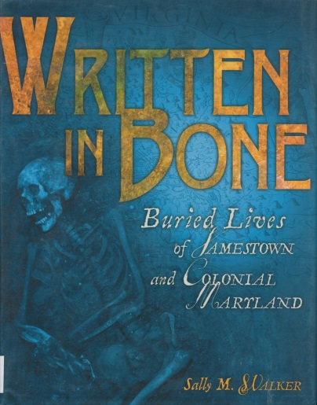
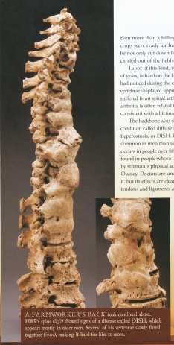
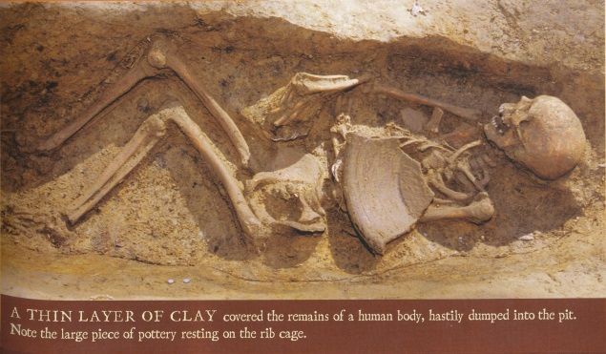
The Bone books
Notes:
Quality content and writing:
Just finding things that kids might be excited by, tap their interests. It may seem gruesome, but I have my greatest successes with books about death and dead people, or some of gross and gruesome things.
These three books, I put together just so you didn’t have to keep seeing skulls popping up all over the presentation. All three of these are written incredibly well, with fascinating stories and a lot of unique content. And as you can see, each of them is very well illustrated. They are addressed to various age levels; primarily beginning with upper elementary, early middle school and older.
Phineas Gage is the story of a man that survived an unbelievable railroad accident in which a gigantic iron rod pierced his brain, and how it changed his personality (but not his intellectual function) as a result of the brain damage.
Faces from the past is specifically about using forensic facial reconstruction to give individuals from long ago (often completely unknown) an identity and using those facial reconstructions to try to fill in gaps histories both broader and personal.
Written in Bone is similar, in that they address several individual cases, using archaeology and forensic studies to understand the lives of our earliest European Settlers in Jamestown and parts of Colonial Maryland.

Slide 19
Print Features
Table of Contents – IDs key topics in the book and their order.
Index – Ability to see everything in the text organized alphabetically and with pg. #s.
Glossary – Provide definitions for words in the text.
Preface – Set a purpose for reading, overview of content.
Pronunciation Guide – Help with saying the words.
Appendix – Offers more information.
Bibliographies or Works Cited
Further reading…
Notes:
Here’s some of the less exciting stuff. Yet, these are important elements to good nonfiction. I think these are pretty straightforward. I do, however, think that bibliographies or works cited deserve separate recognition.
Straight out of the guides I gave you.
These are important because children that are exposed to these features, and taught about their functions will be more familiar with how to use books. The hope is that this would encourage independent and continuous learning throughout their lives, and improve their information seeking behavior.
I don’t always love pronunciation guides, but for readers that have never encountered a set of terms before this is very helpful, however ridiculous the mode of teaching that pronunciation might be. Case in point, my best friend was a voracious fiction reader all her life, and made it all the way to her senior year in high school thinking Writhing was pronounced rithing.

Slide 20
Organization
Bold Print – connecting that term to the glossary.
Colored Print – highlights importance of term.
Italics – highlights importance of term.
Bullets – emphasizes key points/concepts.
Titles – Helps locate categories within the text.
Headings – helps to ID topics throughout a book when scanning.
Subheadings – Similar function to headings on a finer level.
Captions – should help readers understand the relation of a photo to text.
Labels – further information for pictures/parts.
Sidebars – gather additional or explanatory information.
Notes:
Scanning is an essential skill in researching…so while we do want our readers to be reading cover to cover…it’s important that they know how to scan as well, and all these elements help with that. Also, when they know what to look for, they know what information is more significant, and they can sharpen their skills of deduction, and understanding of informational and presentation structure.
How do readers know what the author thinks is important?

Slide 21
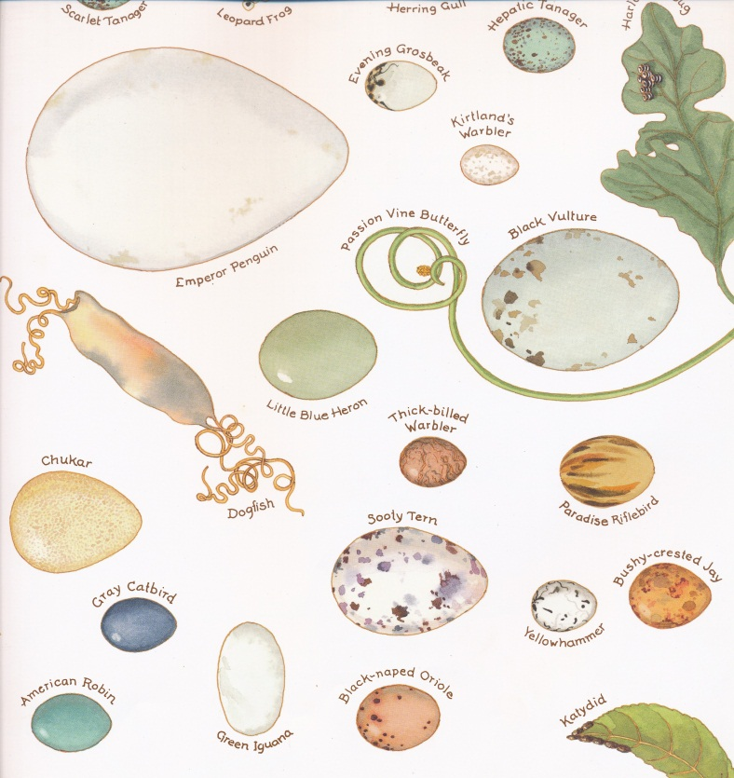
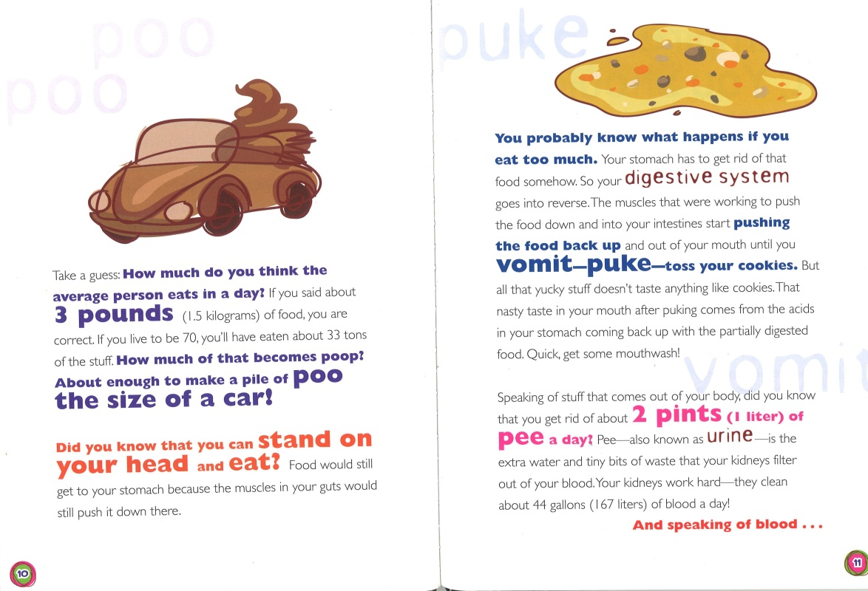
Organization?
Notes:
Artistic way to label and illustrate variation in the subject matter, from An Egg is quiet.
Sidebars from Photo by Brady, highlight the concept in which photos were passed up or missed, by Brady’s photographers.
Overuse of varied text styles!

Slide 22
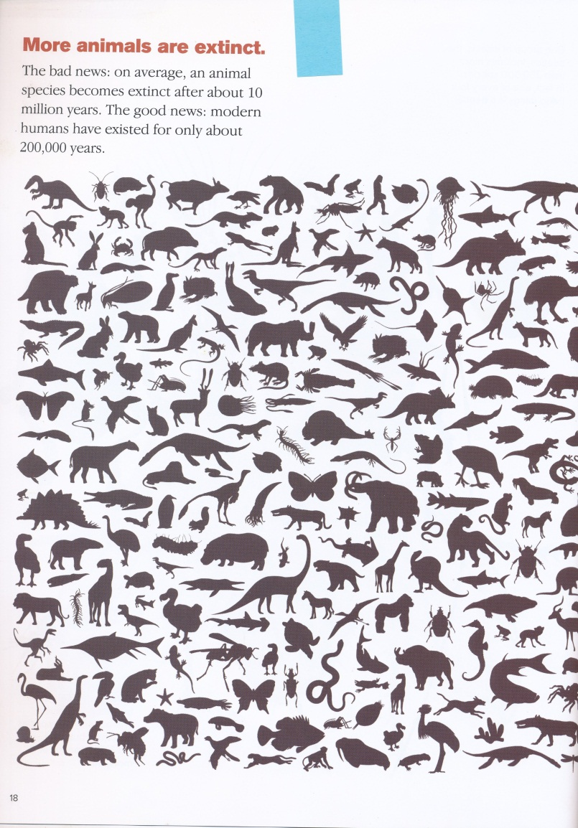
Design/Graphic Aids
Diagrams
Flow Charts/diagrams
Sketches
Comparisons
Graphs
Figures
Maps
Charts/Tables
Cross-Sections
Overlays
Timelines
Notes:
There were a few too many of these to put all the definitions on this slide, and honestly, I believe a lot of these fall under some of the same categories. However, I’m just trying to follow what the original creator of the chart intended, you can look to your handout to see what each of these elements assists in.
Their effect is pretty straightforward. They all serve to demonstrate or help a reader visualize and understand a concept further.

Slide 23
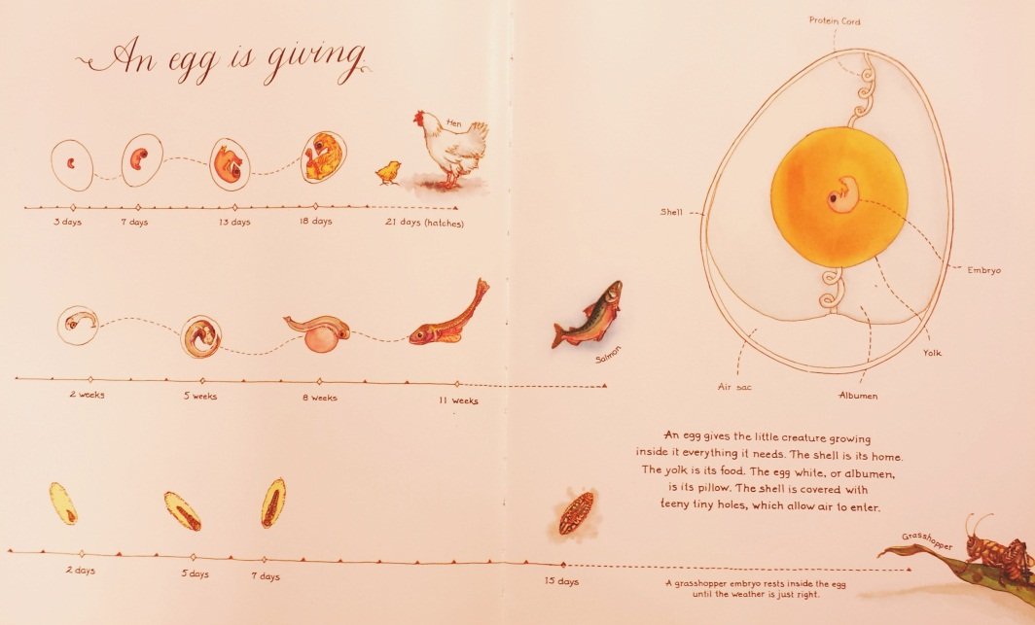
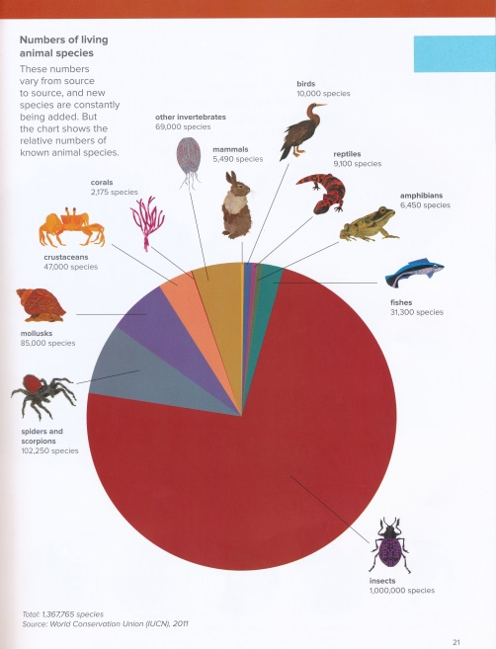
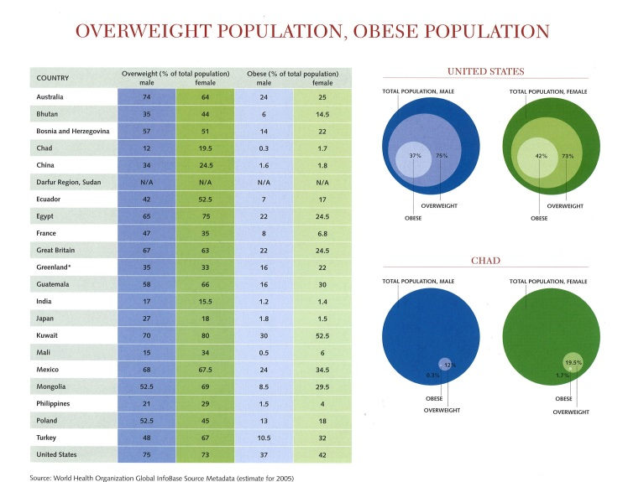
Graphic Aids
Notes:
Charts, timelines, graphs, maps…all of those things are taught to us in nonfiction reading. There are times that these elements turn up in fiction. But clear understanding of them comes from repeated experience with informational texts. These are some fun examples of how these elements can be used in good informational texts
The pie chart is from The Animal Book by Steve Jenkins and Robin Page, and shows the number of extant or living species in each class.
The timeline is from An Egg is Quiet. It is a very different, but visually appealing and artistic depiction the various development cycles of different kinds of eggs
The last graphs and charts are from the book What the World Eats. They show the sometimes disturbing disparities between populations in nutrition.

Slide 24
Illustrations!
Photos – understand exactly what something looks like.
Historical photos
Photos of work being done
Drawing – understand what something could or might have looked like.
Frequently used for topics where something doesn’t exist, eg. Dinosaurs, prehistoric life, paranormal, fairytales/folklore
Any other sort of artistic rendering can inspire curiosity not just of the subject but of the art itself
Magnification – see details in something small.
Notes:
One of my favorite things in any nonfiction! Often enough we as adults want to steer readers away from books with too may pictures in them. But I’ve found myself more frequently drawn to nonfiction with wonderful illustrations.
Illustrations are important. They can make or break a nonfiction book for young readers just as they can a picture book. While we frequently want children to pay attention to the text for comprehension purposes, the quality of illustration is paramount.

Slide 25
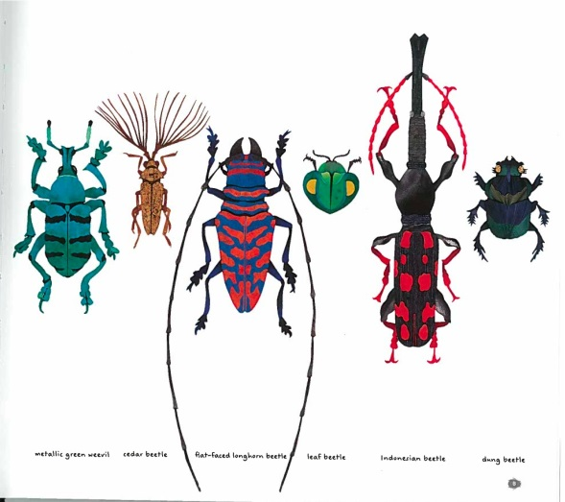
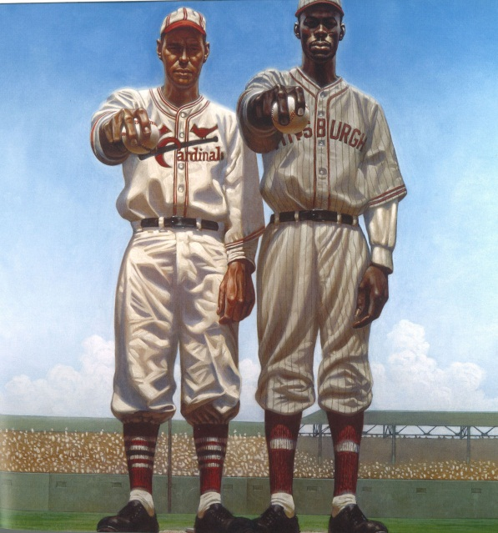
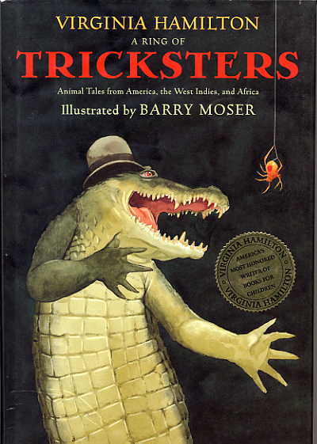
Illustrations with Impact
Notes:
The family on the top from Chad survived on what is the equivalent of:$1.22 a week for food. Compared $341.98 for the Revises of the US. The picture of the spine in the middle, is what a spine badly damaged from an extreme form of arthritis looks like… part of the finds from the old Jamestown Settlement -presented in Written in Bone, that illustrates just how difficult life was for the first European settlers of the US. The haunting oil paintings of Kadir Nelson from “We are the Ship.” Steve Jenkins’ amazing cut paper illustrations for “The Beetle Book.” The precision and whimsy of Barry Moser’s watercolors from Virginia Hamilton’s “A Ring of Tricksters.” Literary nonfiction.

Slide 26
Research/Accuracy
Try your best to valuate for accuracy.
Read reviews carefully.
If something doesn’t sound right, research it.
Cannot catch everything, but our responsibility to at least teachhow to research well, with more than ONE resource.
In nonfiction is it important to always teach kids to use as many different resources as possible.
These elements help teach the research process and support research integrity.
Notes
Glossaries
Citations and source notes
Further reading
Image credits
Notes:
Image credits either on the photo or in the back of the book. Children should be taught what those sections of the book are, so that they don’t simply overlook them as clumps of ignorable text.
While these aren’t always necessary, especially for “fun reading” parents and educators should be aware of them, so they can teach and help select the appropriate resources for their kids.

Slide 27
The Value of Good Research
Notes:
Amazing resource on the research process, and how it did lead to the closest thing possible to a Biography of a legend. Marc Aronson breaks the research process down in the back of the book. Noting that a researcher 1) find what is known already, 2) check their sources, 3) Find gaps and disagreements and formulate ones own questions 4) looking for new evidence, 5) expanding the search 6) sharing what you have
Find a good quote?

Slide 28
Is it for everyone?
YES! But…it takes some work to find the right resources for each reader.
It will have to be with Common Core State Standards
There are different levels of content based on target age group, and reading and interest levels. These are different things.
HI-LO: High Interest/lower reading level
Topics that are of interest to a broad range of readers
Lower level for readers whose skills aren’t quite up to par
Good for introductions
Gateway reading
High quality younger level reading
Good for introducing some reluctant readers to the classification
Sometimes it’s all there is
High quality higher level reading
Notes:
It’s okay for kids to read below or above their level, sometimes. Or to read things that aren’t the highest quality writing. As long as it’s not all they’re doing. Especially for non-fiction, reading intended for their “age group” can appear very daunting.
The pendulum can swing wildly in the other direction as well. Certain topics will not be covered well in one range or the other. Some readers will end up with publications that are targeted well below and above their grade level.
In the case of intermediate to high school students I like to use books that are high interest but lower reading level to introduce kids to a subject. (Phineas Gage, Bodies from the Ash, Bushnell’s Submarine) – But I’ll also use those books for younger readers that are capable of handling the challenge.
Each reader is different, and it’s important to remember not to force things with them. We are all so intent on getting children to a particular level, and somehow (I don’t know how) librarians, parents and teachers must find a way to get them there without scaring them off reading. As librarians we see this happen a lot; Adults that force children to read things they don’t want to, or assignments that essentially ensure that a student will despise reading forever.
There’s an award called the Alex Award given by the American Library Association, to adult books that are considered good reads for young adults. They are not always nonfiction, but nonfiction frequently turns up. It’s a good award to follow for that purpose.

Slide 29
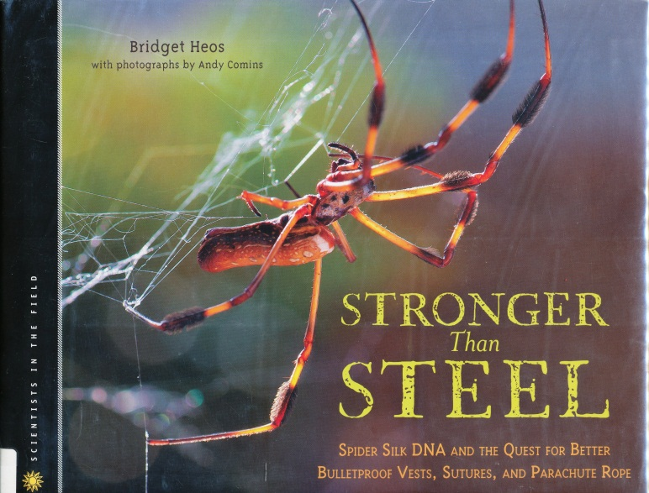
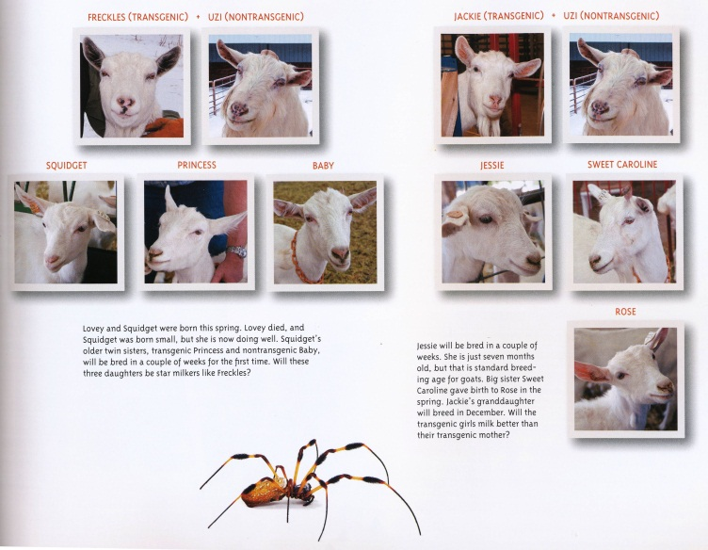
Various levels for different kinds of readers…
What is the difference between High Interest/ Low Reading Level and High Quality/ “different” Reading Level?
“Because of its toughness, people have sought spider silk for a long time. ..But it has always been difficult to come by… a golden shawl 11’x4’ …took 74 people 4 years to collect enough [spiders] for the project, and another 12 to reel in the silk from the spiders.
Notes:
Contrary to popular belief there is not a book written about every topic in the world that is appropriate for every audience YOU might be looking for. And even if there was, it wouldn’t mean that it were in the library, book store, or even STATE that you were in. What is available may also be of poor quality. So there are times that it is necessary to read up or read down.
For example: This book on the use of spider silk as a mass produced material for human consumption … is the one of the only things in print in the library’s collection on transgenic experimentation. And specifically about the experiments being done on producing spider silk. double check. Nothing higher. Probably things in journals and newspapers, but no books based on it. For only 70 some odd pages, intensely scientific discussion

Slide 30
Pure Nonfiction vs. Creative Nonfiction
Pure nonfiction informs and instructs, sticking to the facts Creative nonfiction includes a/the story surrounding the facts by introducing place, scene, setting
Pure nonfiction describes the subject(s) Creative nonfiction adds characterization so that the reader becomes involved and can relate to the subject.
Pure nonfiction is journalistic and scholarly Creative nonfiction employs a literary voice-a tone- to the story
Pure nonfiction focuses on fact. Creative nonfiction allows the reader to hear the author’s perspectives
Pure nonfiction is thoroughly researched Creative nonfiction is thoroughly researched
Pure nonfiction never invents dialog, facts, or events Creative nonfiction shouldn’t either- theoretically
http://donnabowmanbratton.blogspot.com/2010/08/nonfiction-vs-creative-nonfiction-vs.html
Notes:
Some other thoughts on the difference between “pure” nonficton vs. creative nonfiction

Slide 31
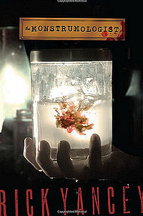
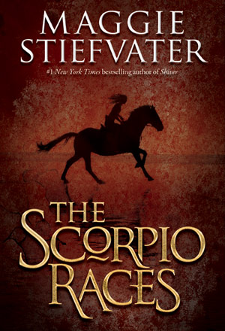
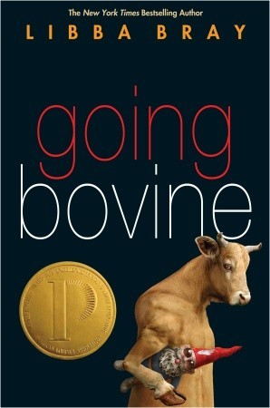
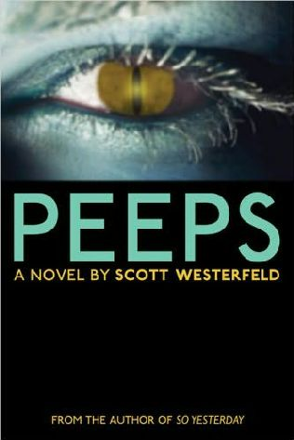
Make connections
You can always find ways to link fiction to non-fiction
Many educators do this already, particularly with historical fiction
Science fiction →sciences
Fantasy → folklore
Notes:
Nonfiction can be linked to fiction – good examples – Peeps (Parasites), Going Bovine (Mad Cow vs. Kreutzfeldt-Jakob). Science Fiction
Monstrumologist and Scorpio Races – Folkore and mythology

Slide 32
More Resources
I.N.K. – Interesting Nonfiction for Kids, Blog for children’s non-fiction, by children’s non-fiction authors. http://inkrethink.blogspot.com
INK – Nonfiction Minute – new effort from the creators of the INK blog. http://nonfictionminute.com
Barstow, Barbara, Judith Riggle and Leslie Molnar. Beyond Picture Books: Subject Access to Best Books for Beginning Readers.
ALA Sibert Awards - The Robert F. Sibert Informational Book Medal is awarded annually to the author(s) and illustrator(s) of the most distinguished informational book published in the United States in English during the preceding year.
ALA Alex awards – 10 adult books recognized for their appeal to teen readers. Can be either fiction or non-fiction. Fiction heavy, but some nonfiction comes through.

Slide 33
Thank you!
Any questions?

