Slide 1
Children’s Literature and War
Children’s Literature Hawai’i – 2014
Chaminade University
June 6, 2014 – Session B1

Slide 2
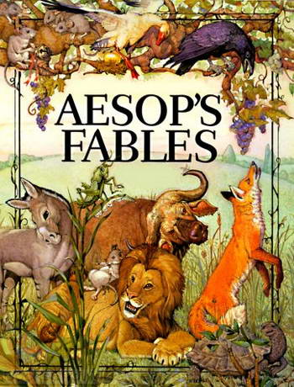
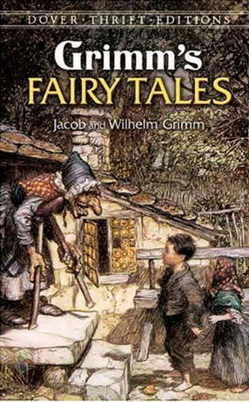
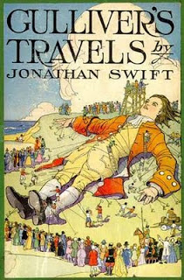
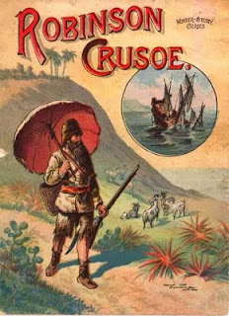
PRIOR TO THE NEWBERY…

Slide 3
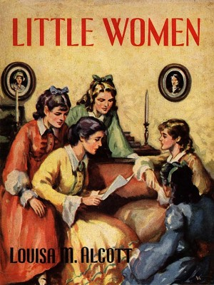
The Advent of Children’s Literature

Slide 4
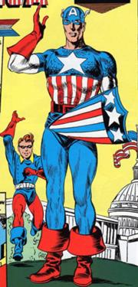
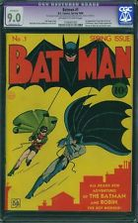
Golden Age of Comics

Slide 5
Contribute to the cause!

Slide 6
Captain America and the Sentinels of Liberty
Free autographed image
Badge (eventually discontinued for the war effort)
Carrying card

Slide 7
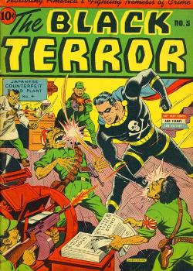
Who’s the enemy?

Slide 8
Maus

Slide 9
Cat versus Maus

Slide 10
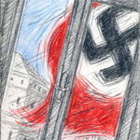
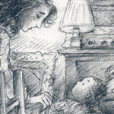
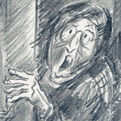
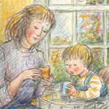
We are on our own

Slide 11
Magneto: Testament

Slide 12
A Family Secret

Slide 13
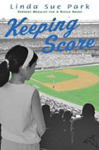
Linda Sue Park

