Slide 1
Hermione and Snotty Save the Day: Female Adventurers and the Confines of Gender
By Dr. Carmen Nolte-Odhiambo
CLH Conference 2014

Slide 2
The Adventurous Hero
Adventurous figures in storytelling and literature are almost exclusively male until the end of the 20th century.
Structure of the adventure tale: hero leaves order/civilization behind and enters an exotic, strange world, is confronted with dangerous characters, experiences, and events, embarks on and completes quests, and finally returns home.
Examples: Odysseus, Tom Sawyer, the figure of the cowboy, James Bond, the boys in Lord of the Flies, Robinson Crusoe, Tarzan, Frodo

Slide 3
The Adventurous Hero
Following the predominantly realistic literature for children and young adults in the 1970s and ‘80s, the 1990s saw the rise of a fantasy literature that incorporates and adapts elements of adventure stories while also including and forefronting an increasing number of female characters.
The setting changes from “exotic“ and often colonial spaces such as the South Seas or the Wild West to magical otherworlds that closely resemble our contemporary society.
The decline of colonial themes in adventure tales in the 20th centure as well as a critique of male heroism contributed to the rise of female heroines who have both “feminine“ traits, such as communication skills and communal thinking, as well as “masculine“ traits, such as independence and bravery.

Slide 4
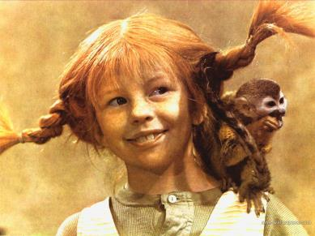
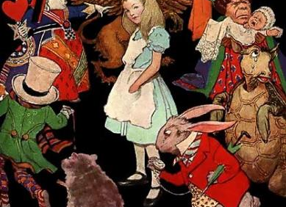
The Adventurous Heroine
Female adventurers remain few and far between until the mid-‘90s. Notable exceptions include Alice (in Wonderland), Pippi Longstocking, and A Wrinkle in Time‘s Meg Murry.

Slide 5
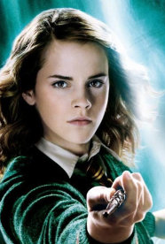
Hermione Granger
JK Rowling‘s Harry Potter series (1997-2007)

Slide 6
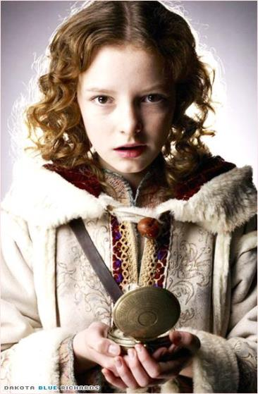
Lyra Belaqua
Philip Pullman‘s His Dark Materials trilogy (1995-2000)

Slide 7
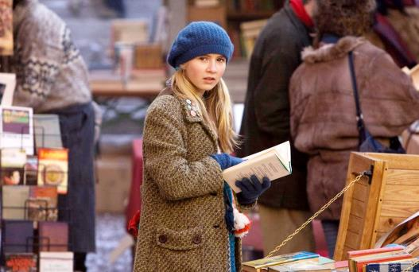
Meggie Folchart
Cornelia Funke‘s Inkheart trilogy (2003-2007)

Slide 8
Points of Comparison adapted from Manuela Kalbermatten
The impulse to leave home
Adventure as a learning process
Masculine and feminine traits
Independence vs sociality
Nature vs culture
Love and sexuality

Slide 9
The Impulse to Leave Home
Individual motivation: rescuing a loved one → Hermione wants to save her friend Harry, Lyra wants to save her friend Roger, and Meggie wants to save her father Mo.
Social motivation: reestablishing order → Hermione sets out to defeat Voldemort, Lyra wants to establish the “Republic of Heaven,“ and Meggie fights against tyrant Capricorn and his evil army.
Emancipatory Function: Unlike (male) adventurers from the 18th and 19th centuries, Hermione, Lyra, and Meggie are complex characters with both strengths and weaknesses. Their realistic portrayal as “normal girls“ facilitates reader identification and encourages young women to transcend gender confines and explore previously forbidden realms.

Slide 10
Adventure as a Learning Process
Adventure serves to initiate individuation, the process of becoming a fully formed human: Hermione, Lyra, and Meggie all show natural curiosity, the desire to learn about and experience the world, and the willingness to disregard pre-established rules in order to form and realize their own values and ethics. → Hermione on the train to Hogwarts: “I do hope they start right away; there‘s so much to learn!“; Lyra realizes that “There was a great deal in the world to know“; and Meggie “wanted to taste and smell and touch the inkworld,“ this world “filled with wonder and adventure.“
These novels, unlike some other adventure tales, all show parallels to the Bildungsroman (coming-of-age novel) and highlight the subversive potential of individual learning.
Learning does, however, remain tied to adventure: the heroines develop their abilities and ethics through confrontation with dangers, obstacles, and conflicts.

Slide 11
Masculine and Feminine Traits
Hermione, Lyra, and Meggie prefer to solve conflicts rhetorically and intellectually rather than through physical altercations (yet all of them are capable of aggression and physical violence as well).
Unlike traditional (male) adventurers, these heroines are not entirely fearless and free of imperfections but rather portrayed as fully human.
Passivity, a trait that is culturally associated with femininity, is depicted as unacceptable
→ Emancipatory aspect: female characters are active and strong even as they sometimes face fear.

Slide 12
Independence vs Sociality
Hermione, Lyra, and Meggie are self-reliant individuals whose autonomy rests in large part on their ability to question (and potentially subvert) societal norms.
Like their traditional male counterparts, these heroines are torn between home and foreign lands. However, while the traditional hero typically misses home for its bourgeois/“civilized“ rules and values, new female adventure figures typically miss the loved ones they have left behind.
While male heroes have often been “lone wolves“ who cooperate or accept help only when necessary, the new heroines are team players who consistently work together with others.
→ Despite their autonomy as individuals, Hermione, Lyra, and Meggie are more social figures than previous adventurers.

Slide 13
Nature vs. Culture
Old adventure tales often emphasize the hero‘s struggle against the forces of nature or against the strange and exotic, culiminating in the protagonist‘s defeat and triumph over nature. While one may expect new tales with female protagonists to describe not the heroine‘s victory over nature but rather, in keeping with traditional traits of femininity, the harmonious living with and in nature, these fantasy novels are concerned not with nature but culture.
As children not of nature but of culture, Hermione, Lyra, and Meggie‘s goal is to shape their society so that it may more closely resemble their democratic ideals.

Slide 14
Love and Sexuality
Portrayals of love and sexuality are complex and various.
Romantic love develops as a part and consequence of the adventure, rather than as a contrasting and conflicting plot alongside it.
Unlike earlier novels for young women, the plot emphasizes not marriage as the final goal superior to all others, but instead focuses on the heroine‘s development and process of individuation, which eventually allows her to choose an equal partner who values her autonomy.
The novels‘ inclusion of love and sexuality among its central themes invites young female readers‘ identification with the heroines. It also presents a new model for the adventurer‘s relationships: rather than depicting the heroine as an isolated lone wolf (as her prior male counterparts often were), the texts showcast characters who value both autonomy and romantic love.

Slide 15
Katniss Everdeen
Suzanne Collins‘ The Hunger Games trilogy (2008-2010)
The impulse to leave home (individual/social/emancipatory)
Adventure as a learning process
Masculine and feminine traits
Independence vs. sociality
Nature vs. Culture
Love and sexuality

Slide 16
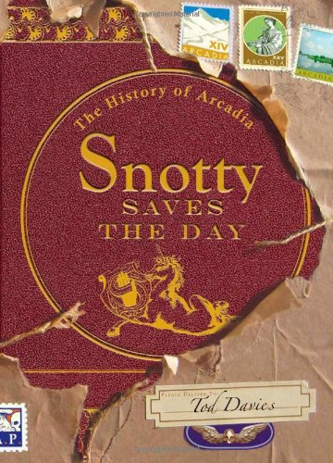
Snotty/Lily
Tod Davies‘ The History of Arcadia series (2011-present)

Slide 17
Snotty and Lily
Masculinity → colonialist, capitalist, individualistic, forceful, aggressive, strong, selfish
Femininity → communal and social, peaceful, weak (and therefore “stronger than the strong“)
Snotty → “horrid nature... He is a repellent brat, and what little criticism there has been of this till now mostly ignored work has focused on the difficulty of relating to such a child as the protagonist“ (from the fictional foreword to Snotty Saves the Day)
Lily → future ruler of Arcadia as just and peaceful Lily the Silent

Slide 18
Snotty and Lily
Snotty Saves the Day presents a patriarchal society similar to ours in which masculine traits are deemed superior to feminine ones.
The text portrays traits typically associated with masculinity, such as aggression, violence, and isolation, in a stark negative light while furthermore connecting it to greed and a lack of empathy.
Feminine traits, such as sociality, tolerance, and peacefulness, suggest an ethically superior society that is presented as a (utopian) alternative to patriarchy. This society shares resources equitably and lives harmoniously with the environment.

Slide 19
Snotty and Lily
→ Although femininity and masculinity are depicted as oppositional and conflicting, the character of Snotty quite literally performs gender (by convincing her peers and almost herself even that she is a boy), emphasizing that people of all genders have feminine and masculine traits. The fact that other characters (and the readers) also perceive Snotty as male for most of the book moreover highlights that gender is socially constructed and performed, and as such it is subject to change across time and cultures.

Slide 20
Some Questions for You...
How does your reading experience change depending on the protagonist‘s gender?
Do you find that you can more readily identify with characters of your own gender?
How do you think characters like Hermione, Lyra, Meggie, or Katniss conform to and/or challenge our ideas of femininity and masculinity?
If you have a child (or children), to what extent do you consider the protagonist‘s gender (and gender conformity) when choosing books for your child to read?

Slide 21
Any Questions for Me?

